Slide 1
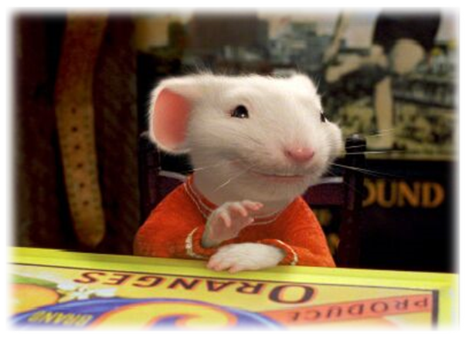
CSE- 4105
Lecturer-06
Transformation-I

Slide 2
Transformations
What is transformations?
  The geometrical changes of an object from a current state to modified state.
Why the transformations is needed?
  To manipulate the initially created object and to display the modified object without having to redraw it.

Slide 3
2D Geometric Transformation
Modeling
Coordinates
World Coordinates

Slide 4
Example: 2D Scaling
Modeling
Coordinates
Scale(0.3, 0.3)
World Coordinates

Slide 5
Example: 2D Rotation
Modeling
Coordinates
Scale(0.3, 0.3)
Rotate(-90)
World Coordinates

Slide 6
Example: 2D Translation
Modeling
Coordinates
Scale(0.3, 0.3)
Rotate(-90)
Translate(5, 3)
World Coordinates

Slide 7
Example: 2D Geometric Transformation
Modeling
Coordinates
Again?
World Coordinates

Slide 8
2D Geometric Transformation
Modeling
Coordinates
Scale
Translate
Scale
Rotate
Translate
World Coordinates

Slide 9
Transformations
Transform every point on an object according to certain rule.
Q (x’, y’)
P (x,y)
T
Initial Object
Transformed Object
x x’
y y’
The point Q is the image of P under the transformation T.

Slide 10
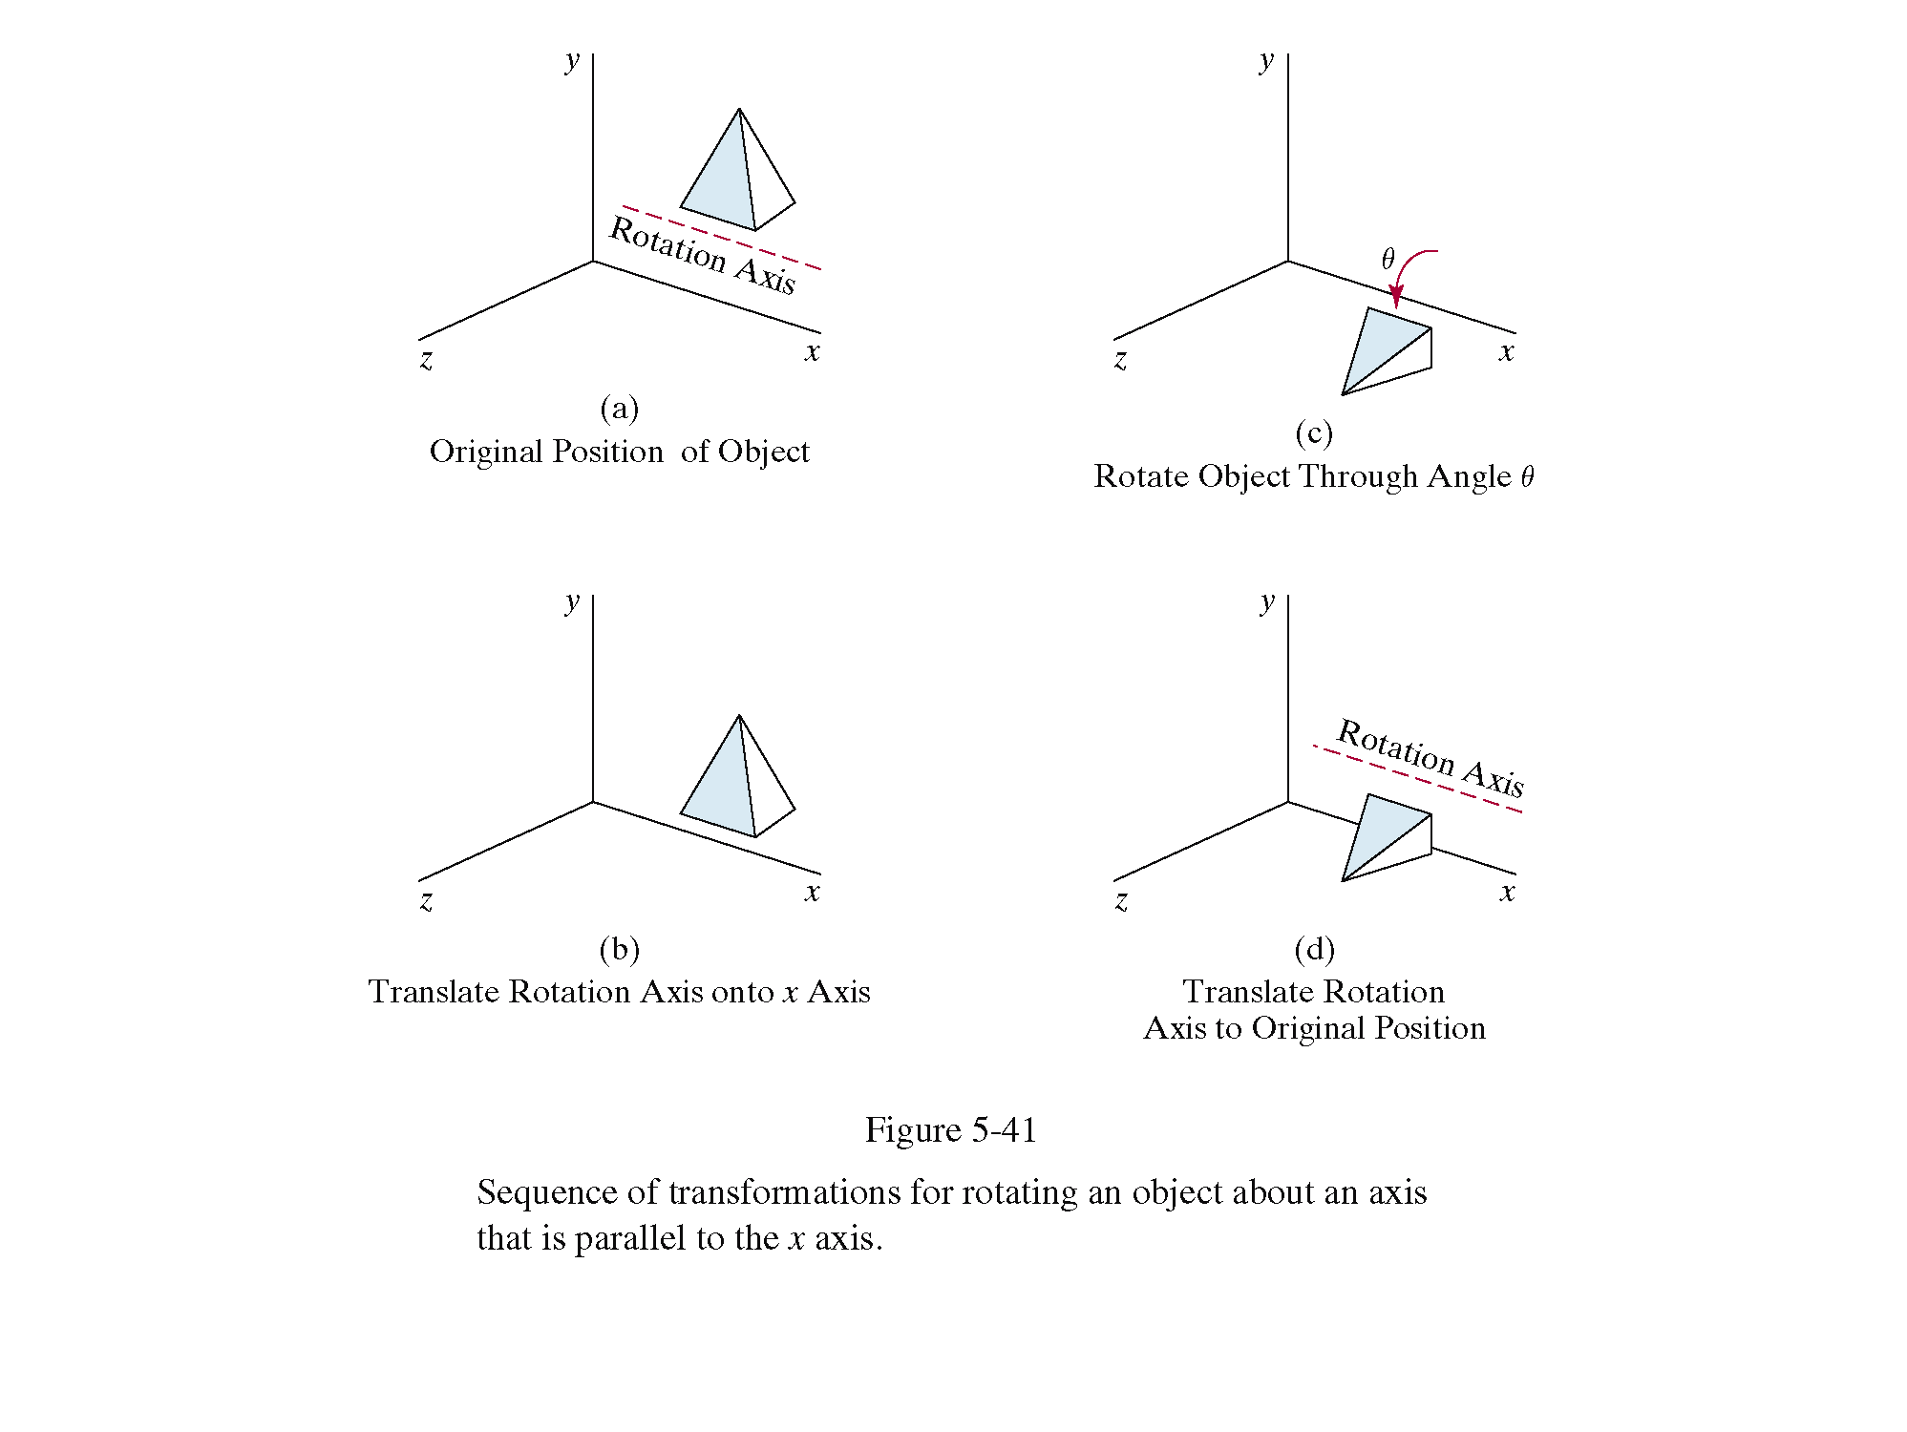
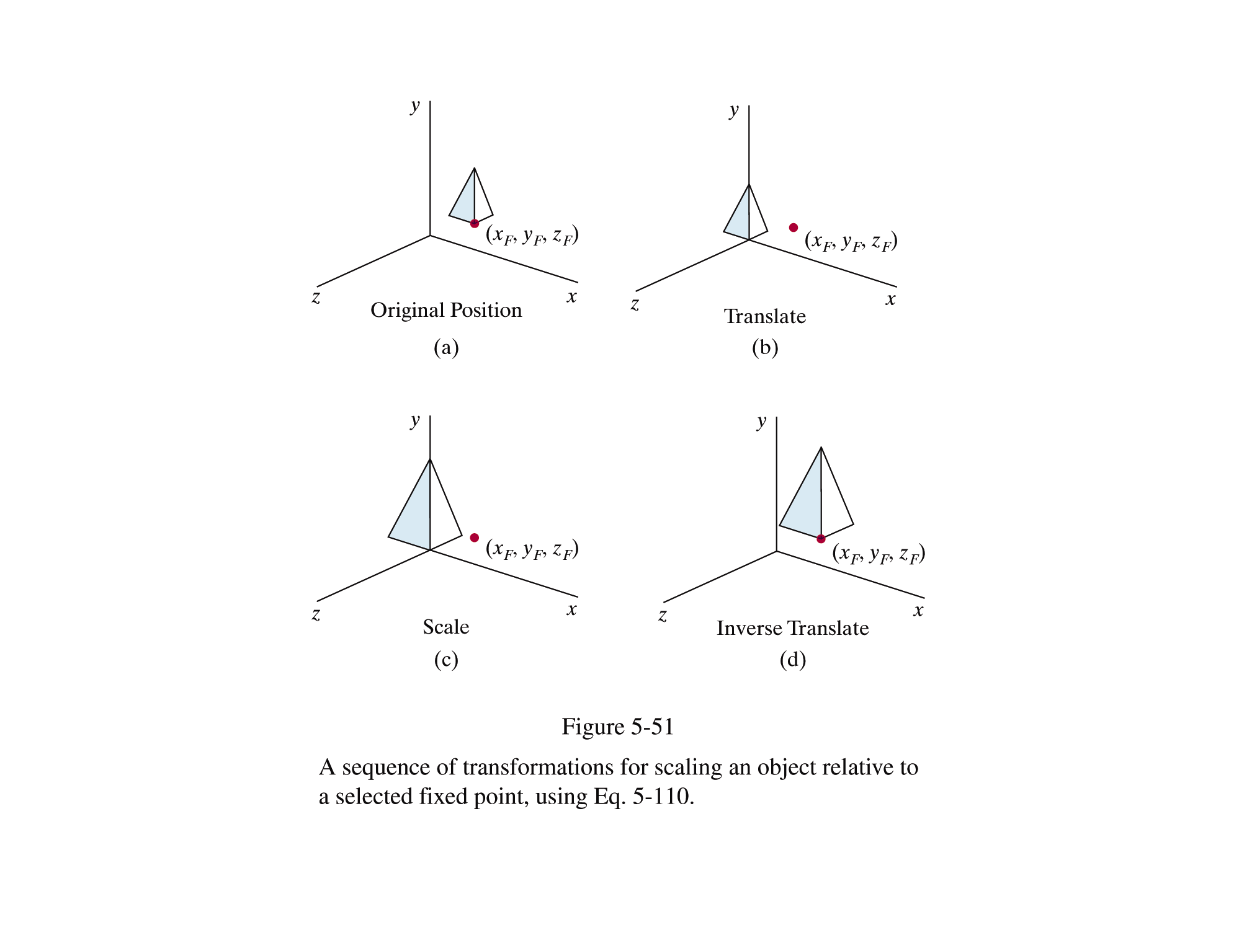
Why Transformations?
In graphics, once we have an object described, transformations are used to move that object, scale it and rotate it

Slide 11
Transformations
2 ways
  Object Transformation
    Alter the coordinates descriptions an object
    Translation, rotation, scaling etc.
    Coordinate system unchanged
  Coordinate transformation
    Produce a different coordinate system

Slide 12
Transformations
Transformations modify an object’s shape and location in one coordinate system
(2,3)
x’=x-1
y’=y-1
y
y
(1,2)
x=x’+1
y=y’+1
x
x

Slide 13
Translation
A translation moves all points in an object along the same straight-line path to new positions.
The path is represented by a vector, called the translation or shift vector.
(8,6)
=4
d_{y}
= 6
(2, 2)
d_{x}

Slide 14


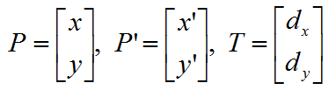

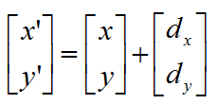
Translation
Represent in in matrix
?
=4
d_{y}
= 6
(2, 2)
d_{x}

Slide 15
Translation
Translation
y
P’(x’, y’)
d_{y}
P(x, y)
x
d_{x}

Slide 16
Translations
(55,60)
(20,35)
(45,30)
(65,30)
(10,5)
(30,5)
The vector (d_{x}, d_{y}) is called the offset vector.

Slide 17
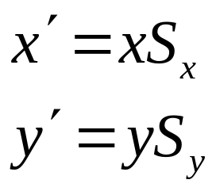
Scaling
Resizes an object in each dimension to altering the size of an object.
Scaling changes the size of an object and involves two scale factors, S_{x} and S_{y} for the x- and y- coordinates respectively.
If S_{x} = S_{y} then uniform scaling then
P’
P

Slide 18

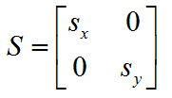



Scaling
Represent in in matrix
y
P₁(x₁, y₁)
y₁
y₀
1
P₀(x₀, y₀)
y₁
2
1
y₀
x
2
1
x₁
1
x₀
x₁
x₀
2
2

Slide 19
Scaling
If the scale factors are in between 0 and 1
The points will be moved closer to the origin
The object will be smaller.
Example :
  P(2, 5), Sx = 0.5, Sy = 0.5
  Find P’ ?

Slide 20
Scaling
If the scale factors are larger than 1
the points will be moved away from the origin
the object will be larger.
Example :
  P(2, 5), Sx = 2, Sy = 2
  Find P’ ?
P’
P(2, 5)
P’

Slide 21
Scaling
If the scale factors are larger than 1
the points will be moved away from the origin
the object will be larger.
Example :
  P(2, 5), Sx = 2, Sy = 2
  Find P’ ?
If the scale factors are the same,
  S_{x} = S_{y} uniform scaling
Only change in size
P’
P(2, 5)
P’

Slide 22
Scaling
If S_{x} ≠ S_{y} ,differential scaling.
Change in size and shape
Example : square → rectangle
  P(1, 3), S_{x} = 2, S_{y} = 5 , P’ ?
P’
P(1, 2)

Slide 23
Thank You

